Slide 1
DATA 621: BUSINESS ANALYTICS AND DATA MINING FINAL PROJECT Presentation Group 2 - Gabriel Campos, Melissa Bowman, Alexander Khaykin, & Jennifer Abinette

Slide 2
Project analysis slide 2
Project Analysis
SPECIFICATION
MODEL
FINAL PROJECT
INSPECT
Conclusions
CLEAN | CONFIGURE

Slide 3




Project analysis slide 3
Specifications
Data Source
Planning
Requirements
Analysis
Reporting
Anti-Defamation
League (ADL)
Format: .csv
Using the data from hate_crime.csv, create a regression model for predicting future anti-semitic crime likelihood
Data Import
Cleansing
Transformation
Train/Test samples
Models
Review findings and assess strength of model
Conclude results from data

Slide 4
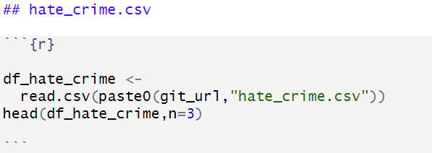
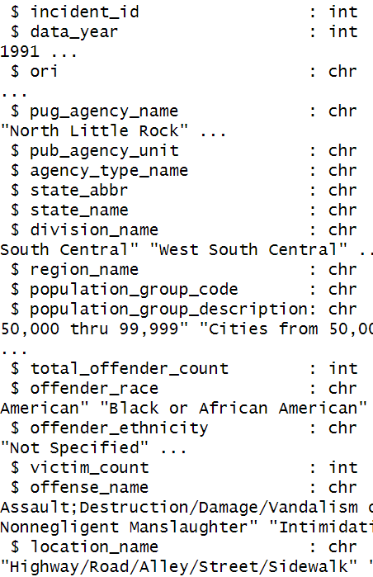
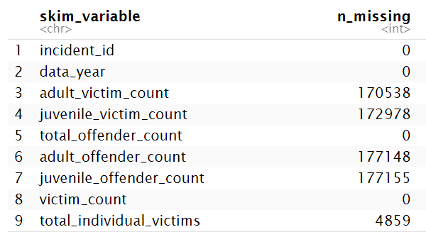
Project analysis slide 4
Inspect
Data was imported from hate_crime.csv sourced from ADL website
Many columns from data source are categorical data
5 columns are noted as having a high number of missing values

Slide 5
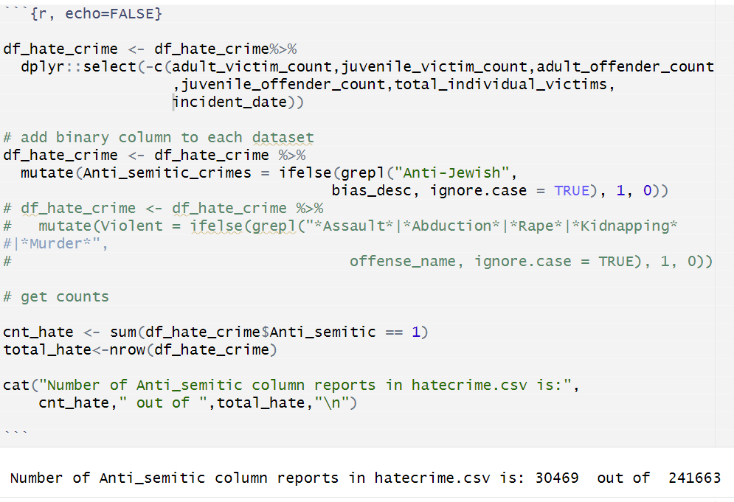
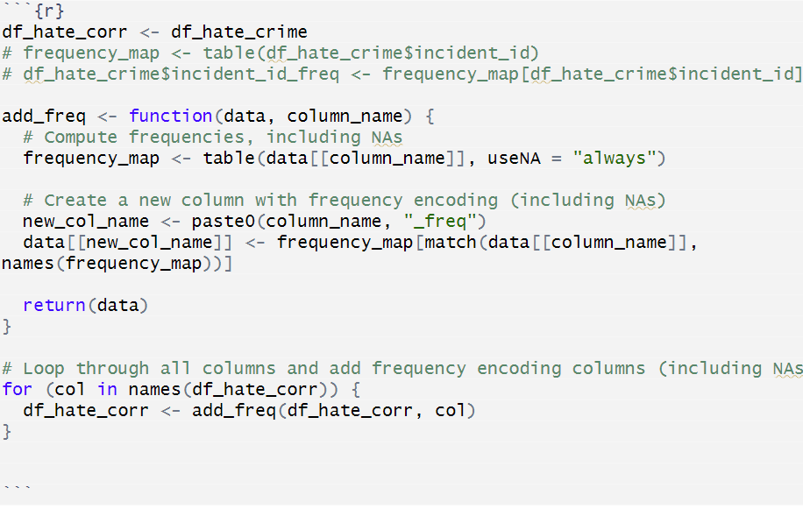
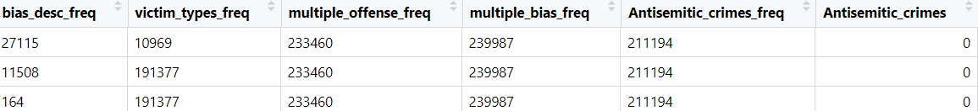
Project analysis slide 5
Clean |Configure
Categorical data point frequencies were used to replace existing categorical values & Binary Column ‘Antisemitic_crimes’ was added to differentiate non antisemitic and antisemitic crimes, then stored to df_hate_corr

Slide 6
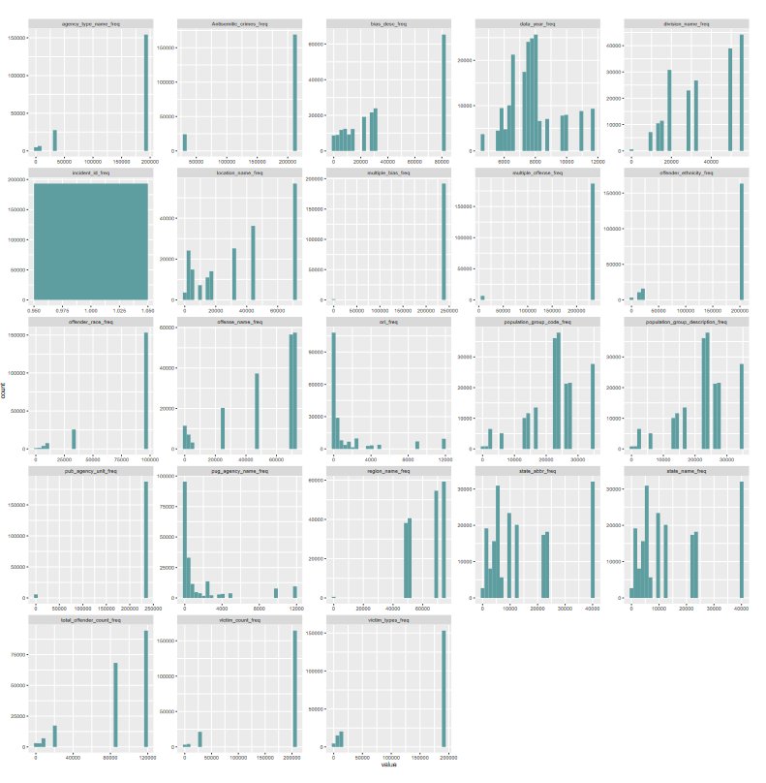
Project analysis slide 6
Clean |Configure
(cont’d)
The Train/Test datasets were drafted using
a 80/20 partition.
Visually we see many attributes lacking any
level of normalization.

Slide 7
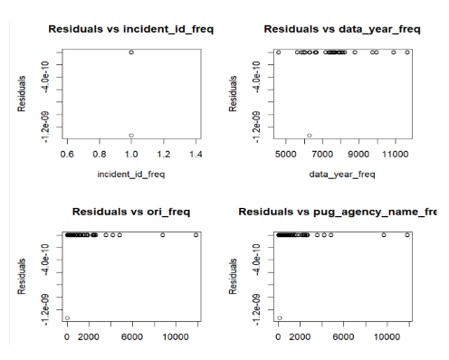
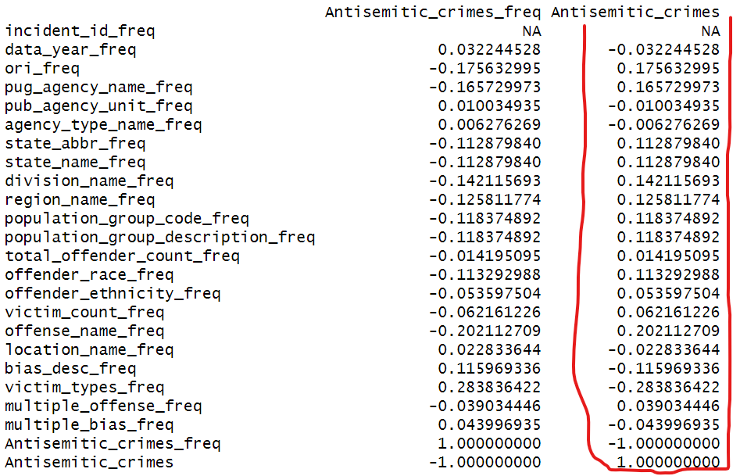
Project analysis slide 7
Clean | Configure
(cont’d)
The correlation values for Antisemitic_crimes show low correlation after the transformation for most columns
Our plots when inspecting for weighted values showed visually showed a lack of heteroskedasticity, due to lacking a ‘fan-like’ or ‘cone-shaped’ pattern.
Obtaining the weighted values was not pursued

Slide 8
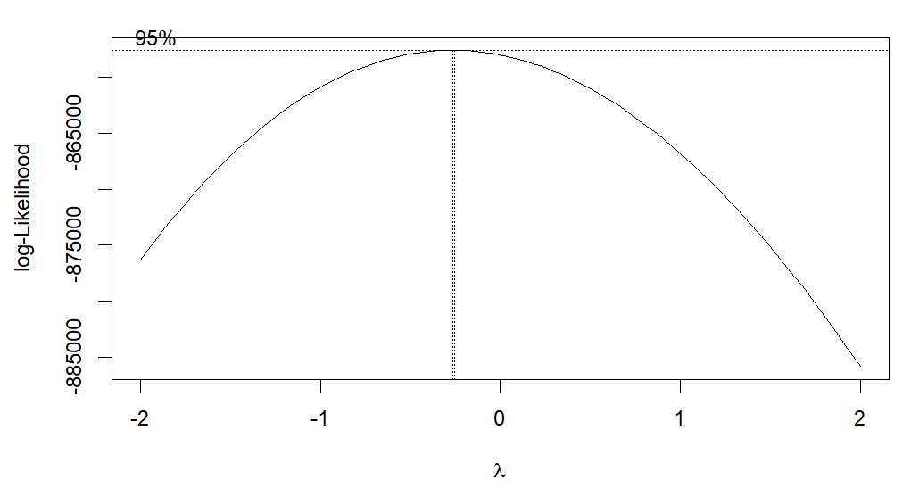
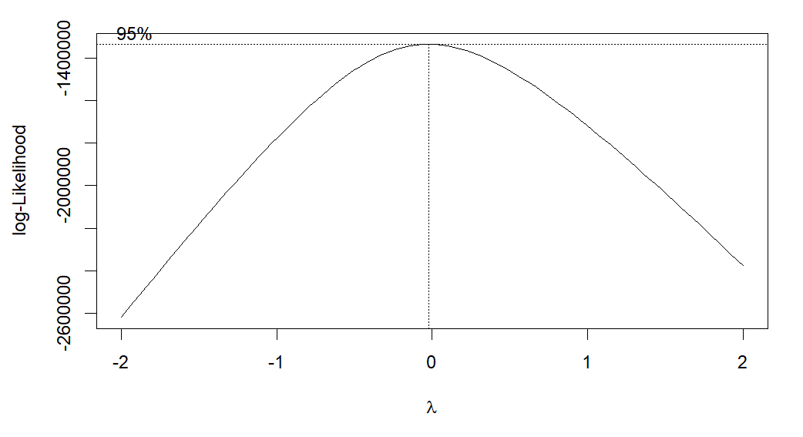
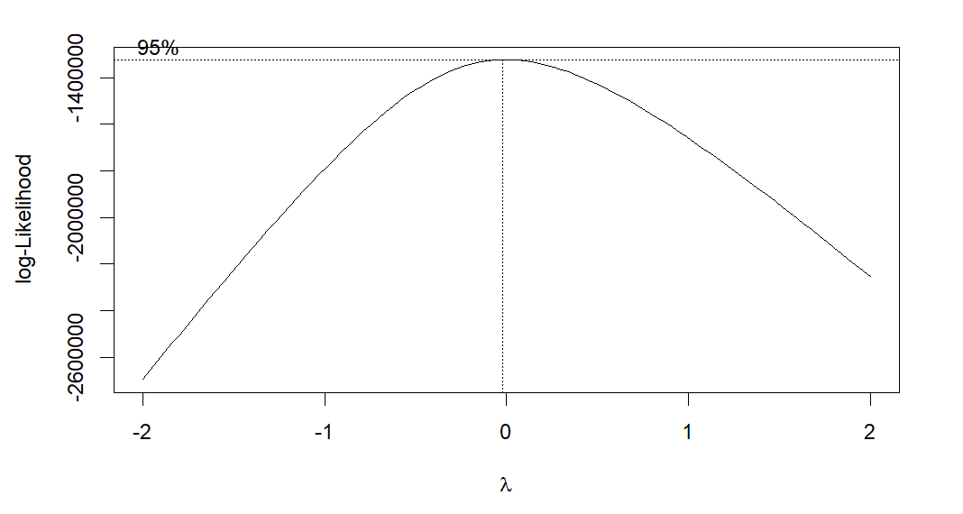
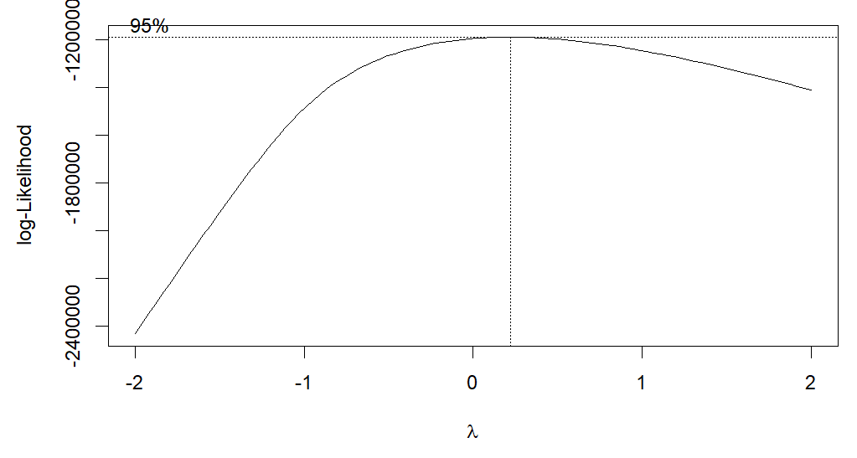
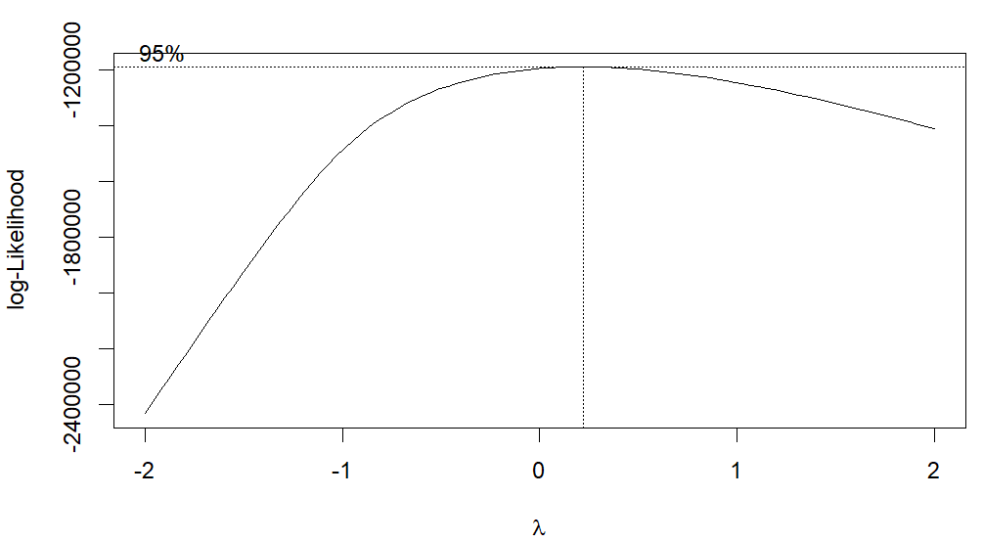
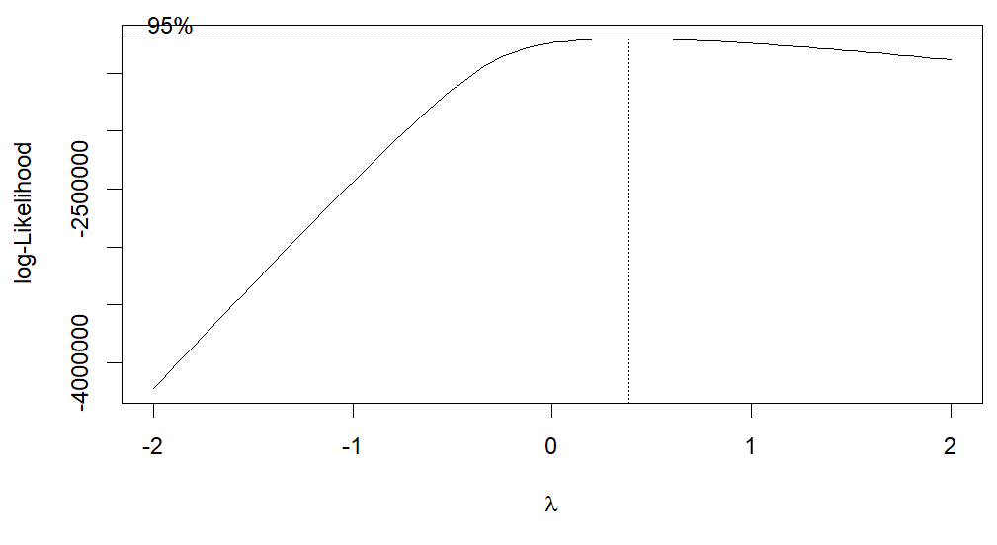
Project analysis slide 8
Clean | Configure
(cont’d)
The below attribute were chosen to utilize the Box-Cox transformation after the excluded variable were identified as incompatible. The Values were appended to the Train and Test dataset.
data_year_freq
ori_freq
pug_agency_name_freq
state_abbr_freq
state_name_freq
bias_desc_freq

Slide 9
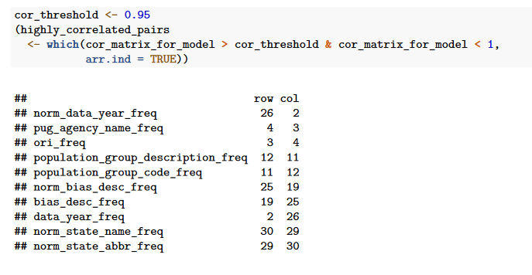
Project analysis slide 10
Model
Function cor() was used to identify the level of correlation for our attribute. Values above the threshold of 0.95 but below 1, was designated at ‘highly_correlated_pair’. The resulting row and column count for highly correlated pairs is listed below.

Slide 10
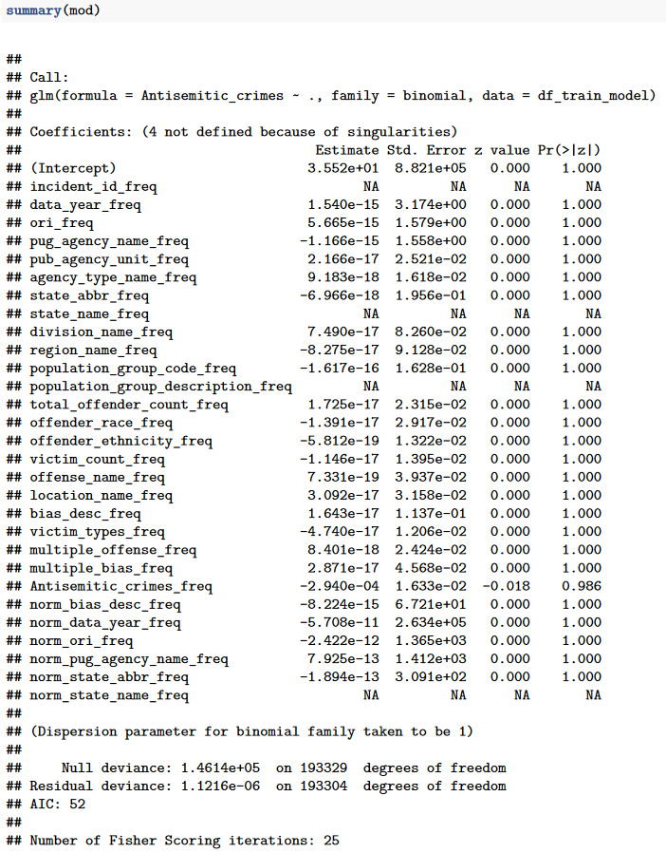
Project analysis slide 10
Model
(cont’d)
Function glm() was used to fit our generalized linear model, which gives a symbolic description of the predictor and error distribution.
Because the crimes were categorized using a binomial value, ‘family’ was set to ‘binomial’ for a binomial regression model.
The results along with summary data indicated a weak correlation.
There is a lack of statistical significance in this model, for our dependent and independent variables.
Notably the Akaike Information Criterion (AIC) value gave a false positive reading for our data.
There was not enough evidence from this finding to reject the null hypothesis.

Slide 11
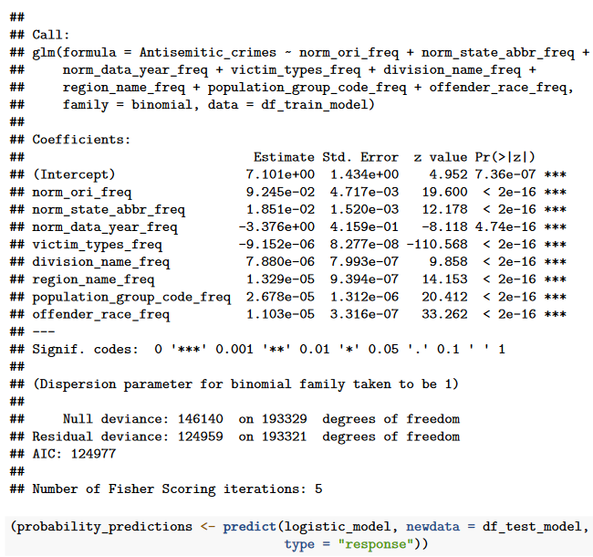
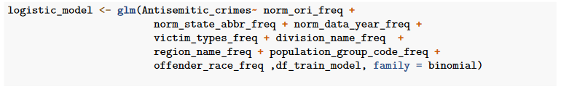
Project analysis slide 10
Model
(cont’d)
After noting the lack of correlation with our model, we used Pearson correlation coefficient method, a branch method using binomial regression, to dive deeper into our highly correlated attributes.
Our AIC indicates it’s a bad model.

Slide 12
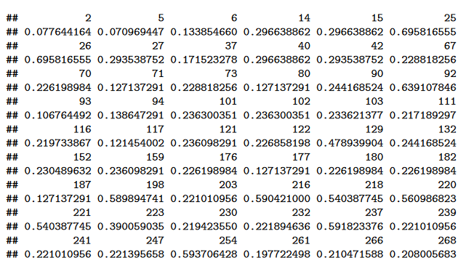
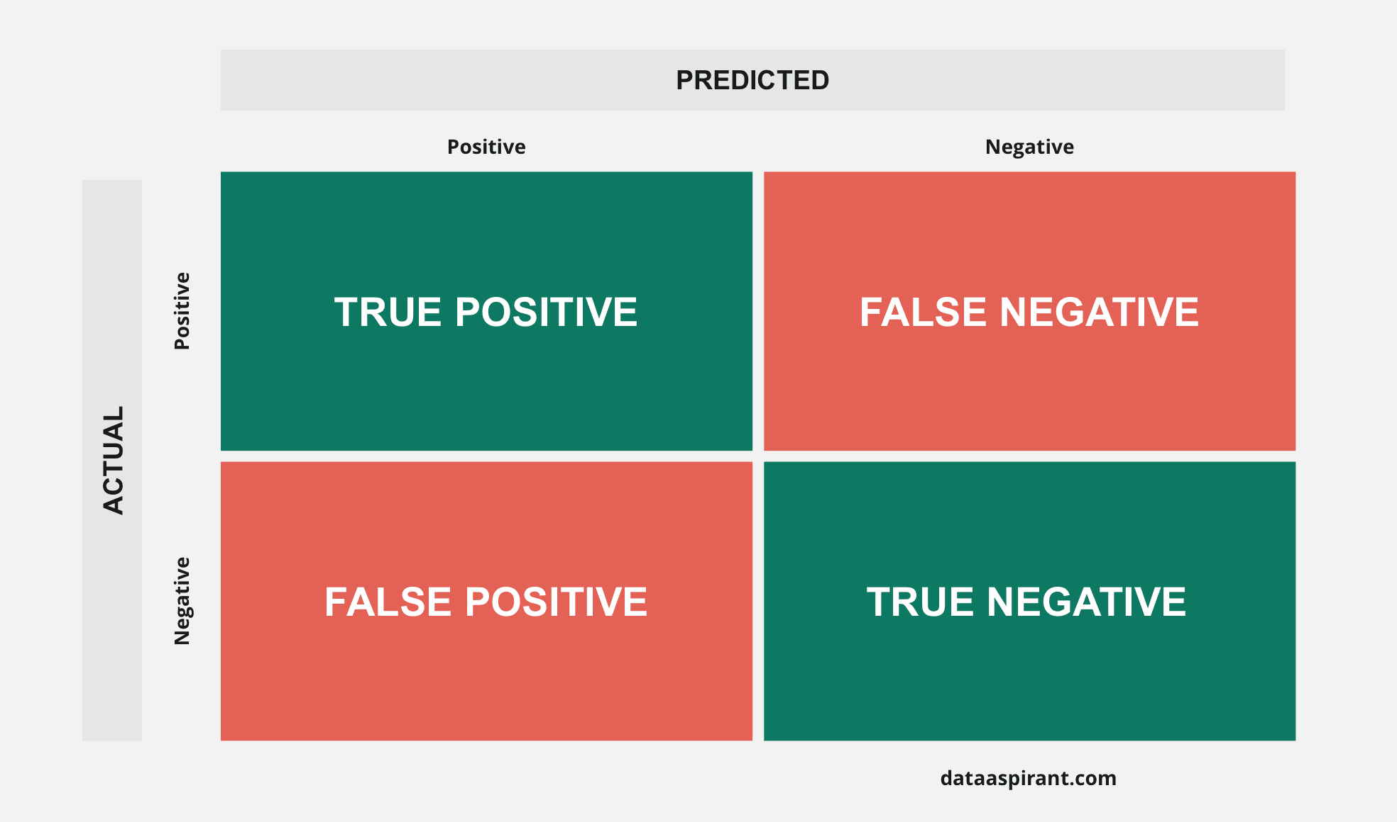
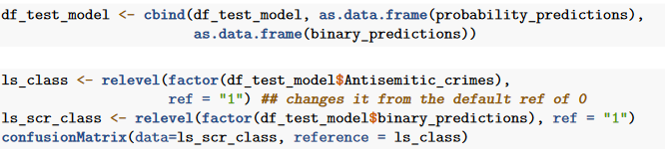
Project analysis slide 10
Model
(cont’d)
Function relevel() was used to transform our negative and positive values in accordance to our confusion matrix need (see below).
This improves precision by partially mitigating false-positives and false-negative.

Slide 13
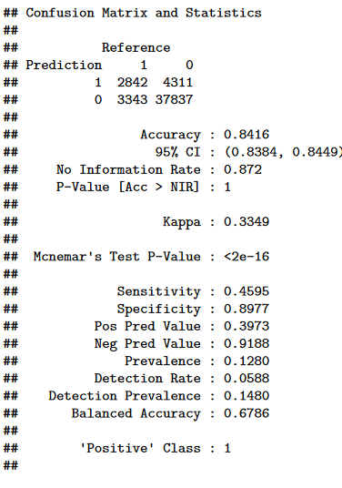
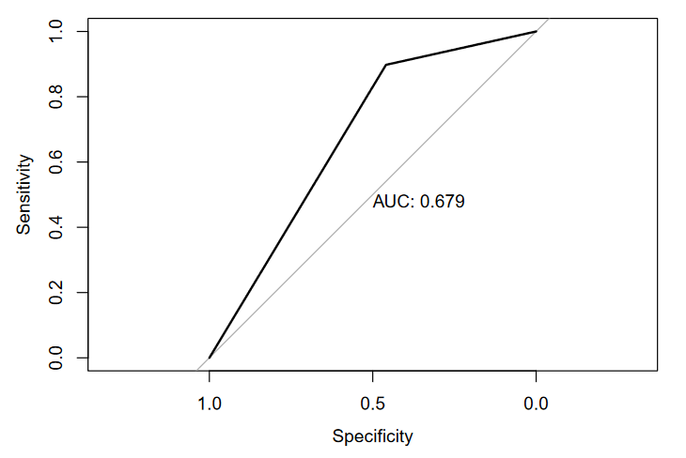
Project analysis slide 10
Model
(cont’d)
Our confusion matrix indicates our model has a costly likelihood of obtaining a false-negative or false-positive
prediction. Therefore it may predict a crime to be antisemitic when it is not or incorrectly
indicate a crime is not antisemitic when it is. These factors make the model a poor fit overall.

Slide 14
Conclusion
Going through the regression steps as per our Data 621 Fall ’23 course, did not result in a model that supported predicting antisemitic crimes. We were able to identify this model is not a good fit from our results. Identifying poor models is a positive step in identifying a good models for the future. Factors that will allow us to identify future stronger models include cleanliness of data, high-correlation, statistical significance and high metrics derived from the confusion matrix.

Slide 15
Thank You

